Slide 1
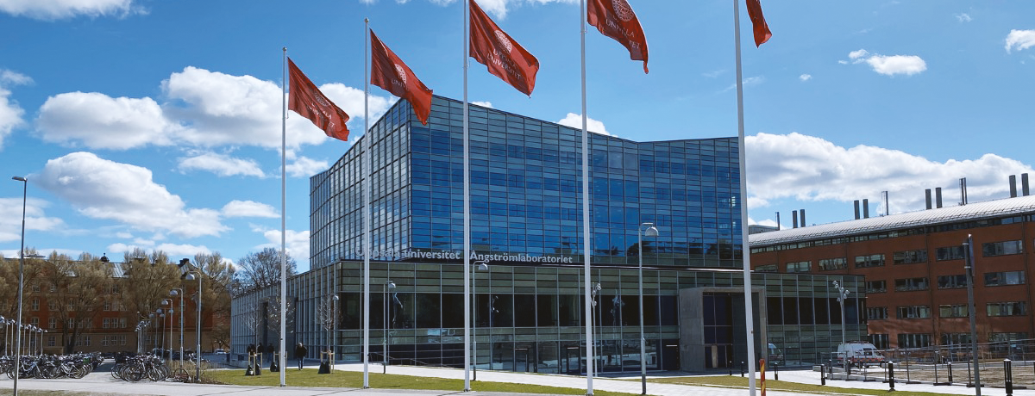
Exjobbarna är vår framtid!
Medtech4Health Innovation Hive 17 oktober 2023

Slide 2
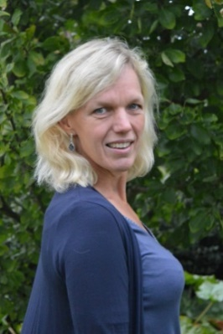
Ingela Nyström Professor in Visualization Department of Information Technology Uppsala University ingela.nystrom@it.uu.se
Board member of Medtech4Health
Innovation Hive 2023-10-17

Slide 3
What is an Exjobb? – Thesis Projects
take place in the final phase of the studies
are courses offering the student practice in planning, developing, implementing, documenting, and presenting independent work
provide the student with contact with research and development work
include reading and reporting of selected advanced literature
can take place at a company, a government agency or a university department, in Sweden or abroad
shall result in a written paper, report, which will also be orally presented

Slide 4
Roles involved
Student The student takes ownership of the project, working diligently to complete it, and ensures that it meets the academic standards and requirements set. The student should demonstrate initiative, critical thinking, and problem-solving skills throughout the project.
Supervisor / Handledare Provides guidance and support to the students in order to help them achieve their project goals. A Supervisor can be at a company or at Uppsala university.
Subject Reviewer / Ämnesgranskare Provides an expert evaluation of the project's content, relevance, and quality based on their area of expertise. Their main objective is to assess whether the project meets the academic standards and expectations set by the discipline. A Subject Reviewer is employed at Uppsala University.
Thesis Coordinator Oversees and monitors the entire thesis project process.
Examiner Evaluates the student's work and determines if it meets the standards and requirements set by the program. The Examiner's role is to assess the student's performance and provide a fair and impartial evaluation.
Student Opponent Provides an impartial and constructive evaluation of the project and the presenter's performance, highlighting both the strengths and weaknesses of the work.

Slide 5
A master thesis project is 20 weeks = 30 hp credits often during the Spring term
Every student has the right to a suitable thesis project, however, they should be active themselves in finding projects, for example, they can apply for projects from a Supervisor at a company
Projects should be relevant to the education program the student is a part of
Projects primarily involving implementation work (program design, coding, testing, debugging, etc.) are generally not acceptable as the student should also practice planning, developing, documenting, and presenting project work
Projects where the student is continually working from instructions are generally not acceptable as the student should carry out independent work

Slide 6
Thesis specification approved by Supervisor and Subject Reviewer to be submitted to the Department with forms for registration
Title
Abstract
Background
Description of the task
Methods
Relevant courses
Delimitations
Time plan
Key references

Slide 7
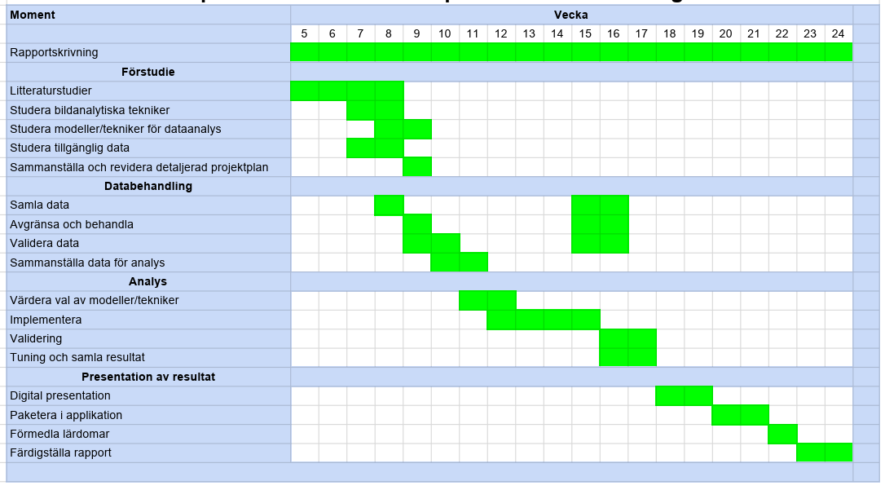
Time plan, example

Slide 8
Example report
Typically, 40–60 pages
Individual work is examined
Possible (but not so usual) to work in pairs

Slide 9
CONDUCTING A THESIS Project
Beginning
Student arranges an introductory meeting with Supervisor and Subject Reviewer to agree on work flow and revise the thesis specification
It is strongly advised that Student and Supervisor meets throughout the thesis project (if not in brief meetings daily at least in a one-hour meeting once a week)
Subject Reviewer is available in the background for Student and for Supervisor, when need be
Middle
Student arranges a mid-term presentation with Supervisor and Subject Reviewer
Opportunity for Subject Reader to review the academic progress of the thesis project
Chance for Supervisor to give feedback on how well the project follows the original plan
Practice for Student to present the project in preparation for the final presentation
End
Student iterates draft versions of the thesis report to Supervisor (and colleagues) who reads and comments on the report
On request from Student, Subject Reviewer decides if the report is ready enough to be allowed to present
Student books time for final presentation, which Subject Reviewer, Examiner, and Student Opponent can attend; Supervisor is warmly welcome to attend
Student makes final changes to the written report in response to the feedback received from Supervisor, Student Opponent, Subject Reviewer, Examiner, and possibly Audience.
Once Subject Reviewer is satisfied with the report, Thesis Coordinator is notified that the thesis has been approved
Student spreads printout and pdf of final report and can with registered thesis apply for exam

Slide 10
Propose thesis projects NOW!
Do you have a problem that needs to be investigated but your employees do not have the time do it or the skill set to comply?
Exjobbare can be your solution with new and recent courses studied!
Are you having plans to recruit from the younger generation?
Exjobbare can be your solution to find a good recruit!
If you wish to find students with strong background in IT, then submit project proposals to exjobb@it.uu.se to reach Exjobbskoordinator
Most students wish to have their exjobb during the Spring term, that is, starting in mid-January and finishing in mid-June

Slide 11
Win-win!
So take on an exjobbare, but please do not employ our students until they have completed their thesis and exam!

Slide 12
Ingela Nyström Professor in Visualization Department of Information Technology Uppsala University ingela.nystrom@it.uu.se
Board member of Medtech4Health
Innovation Hive 2023-10-17

Slide 13
Exjobbarna är vår framtid!
Medtech4Health Innovation Hive 17 oktober 2023

